Slide 1
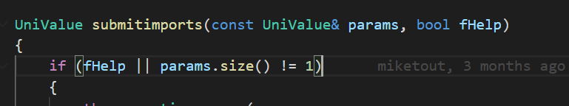
Partial transaction proof serialization breakdown

Slide 2
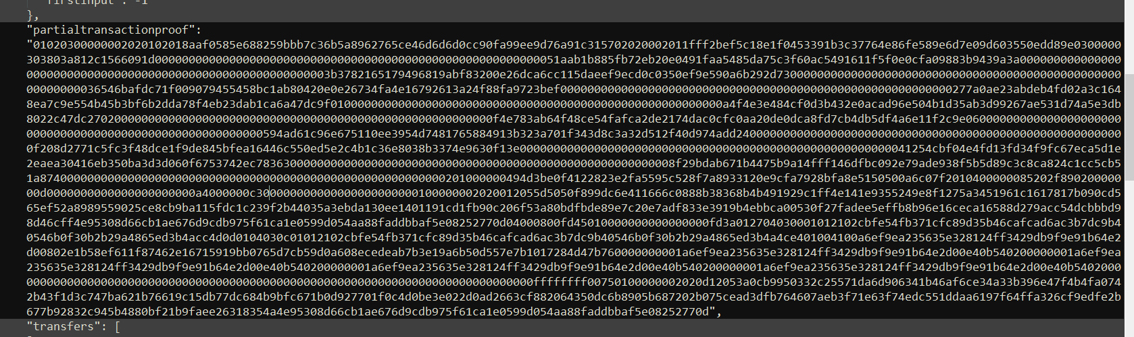
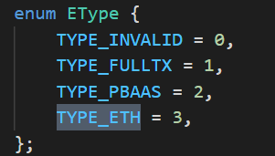
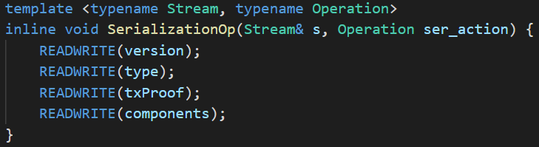
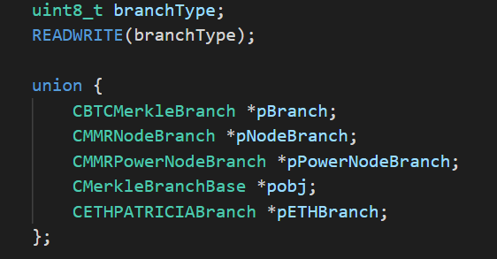

For Ethereum proofs this would be 3
The branch type would be a CETHPATRICIABranch

Slide 3

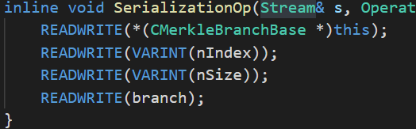

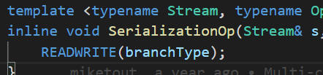
This is a mmr example so the branch proof is a mmr, do we change this to a RLP encoded proof?
Or keep it as close to this as possible have Alan produce an array of uint256 hashes that just have to be hashed detrmined by some defined Patricia tree prefixes?

Slide 4
